Slide 1

Implementing Hybrid Cloud Solutions with Azure Data Factory and Databricks
Hexaware Data Engineering
Project 1: Hybrid Cloud Data Movement

Slide 2

Introduction to Data Integration
In today's data-driven world, effective data integration is essential. This presentation will explore the implementation of hybrid cloud solutions utilizing Azure Data Factory and Databricks to achieve seamless integration and enhance data workﬂows.

Slide 3


Understanding Hybrid Cloud Solutions
Hybrid cloud solutions combine on-premises infrastructure with cloud services. This approach offers ﬂexibility, allowing organizations to manage workloads efﬁciently while ensuring data security and compliance.

Slide 4

Project Requirement
Azure Data Factory
Storage Account
SQL Server Database
Azure Databricks
Integration Runtime Pipeline
Microsoft Integration Runtime

Slide 5

Design Overview & Workfiow
Step 1 : Data Factory Account Setup → Create Data Factory instance
Step 2 : Storage Account & Container → Create Blob Storage Account → Create Container
Step 3 : SQL Server Setup → Self-hosted Integration Runtime (on-premises) or Azure SQL Setup
Step 4 : Install Integration Runtime → Conﬁgure Self- hosted Integration Runtime or Azure Integration Runtime
Step 5 : Data Factory Pipeline Creation → Set Source (SQL Server) → Set Destination (Azure Storage) → Deﬁne Transformations
Step 6 : Setup Integration → SQL Connection , → Storage Connection
Step 7 : Execute Pipeline → Monitor Execution

Slide 6

Benefits of Seamless Integration
The seamless integration of Azure Data Factory and Databricks provides numerous beneﬁts, including improved data accessibility, faster data processing, and enhanced collaboration among teams, ultimately leading to better business decisions.

Slide 7
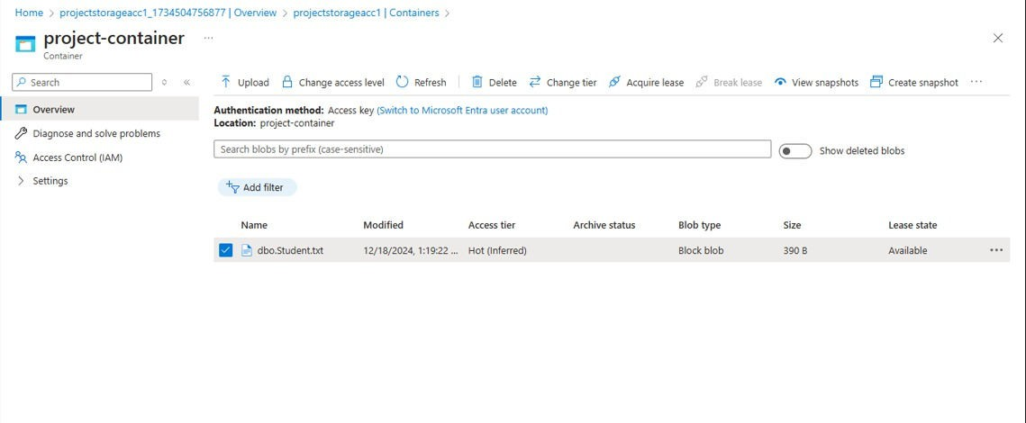
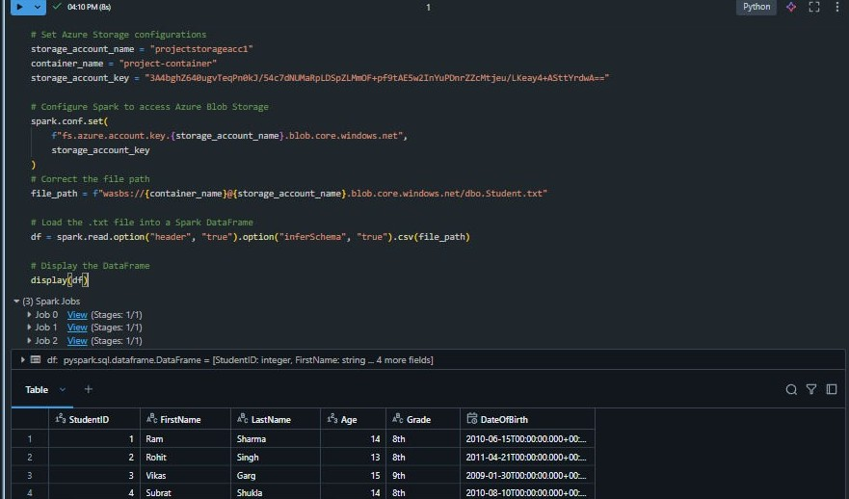
Output Snaps

Slide 8
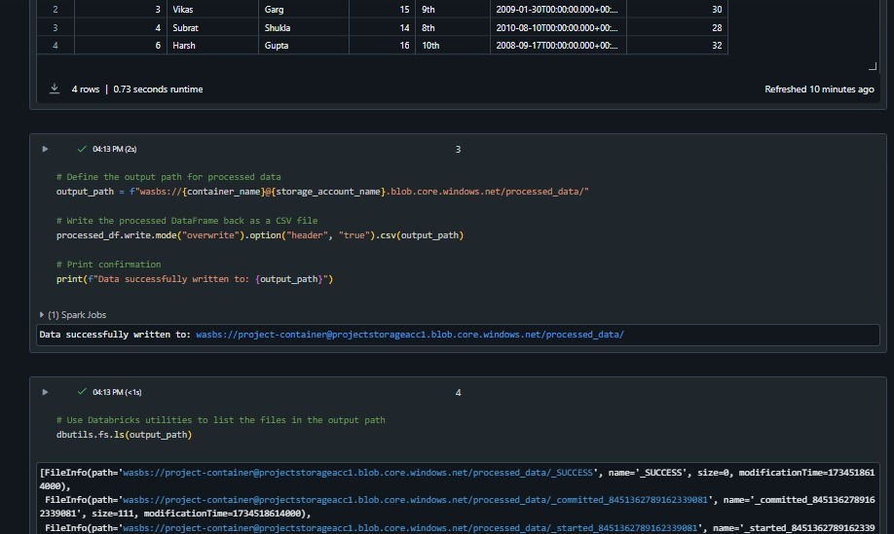
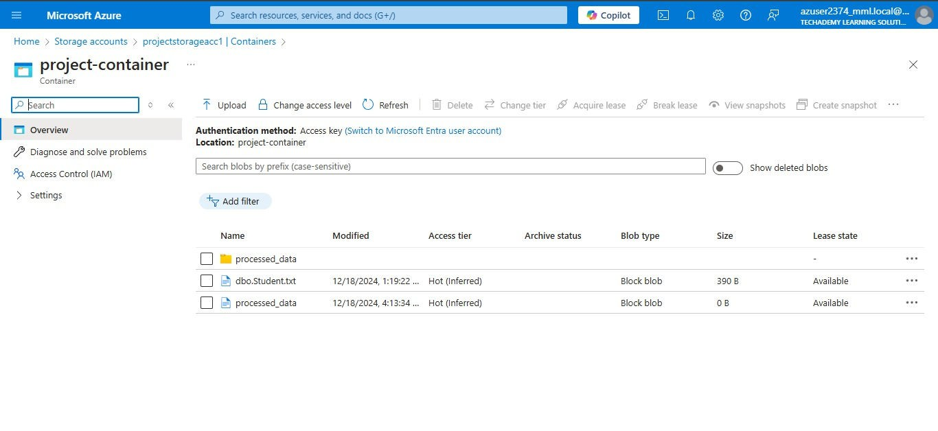
Output Snaps

Slide 9

Conclusion and Future Look
In conclusion, hybrid cloud solutions using Azure Data Factory and Databricks offer signiﬁcant advantages for data integration. As organizations continue to evolve, embracing these technologies will be essential for maintaining a competitive edge in the data landscape.

Slide 10
Thanks!
Team Members:
Aniroop Gupta, DE-1
Harish ER, DE-1
Subrat Shukla, DE-1

